Slide 1

Game Explorer
Welcome to Game Explorer, your ultimate resource for discovering and exploring the vast world of video games.
by Arun Krishnan R

Slide 2

What is Game Explorer?
Game Explorer is a comprehensive online platform designed to connect gamers with their favorite games, news, and communities.
Game Library
News & Reviews
Browse a vast library of games across all genres and platforms.
Stay up-to-date with the latest game releases and read in-depth reviews from experienced critics.
Comparison
Personalized Recommendations
Game Explorer helps gamers around the world to check whether a game is compatible or not
Get tailored game suggestions based on your preferences and gaming history.

Slide 3
Audience
Game Explorer caters to a wide range of gamers, from casual players to hardcore enthusiasts.
Casual Gamers
Core Gamers
Competitive Gamers
Discover new games and find recommendations based on your interests.
Stay up-to-date with the latest news and reviews, and connect with fellow gamers.
Find resources and communities focused on competitive gaming and esports.

Slide 4

Target of Game Explorer
Game Explorer addresses the growing demand for online gaming resources in a globalized world.
1
Accessibility
Provides access to games and information regardless of location.
2
Community Building
Connects gamers worldwide, fostering a sense of belonging and shared passion.
3
Information Hub
Serves as a central hub for all things gaming, from news and reviews to guides and resources.
4
Personalized Experience
Tailors content to individual preferences, enhancing user engagement and satisfaction.

Slide 5
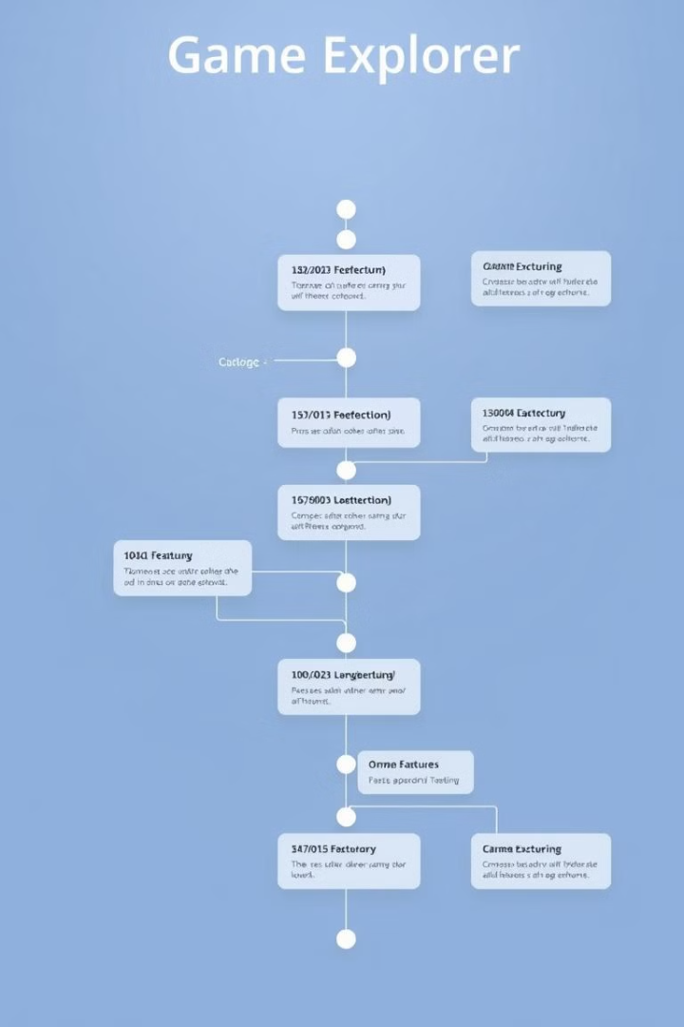
Progress
Game Explorer has made significant progress in its development.
Concept & Design
1
Defining the vision and user experience for the platform.
Development & Testing
2
Building the core features and functionality, ensuring stability and performance of Front-end.

Slide 6
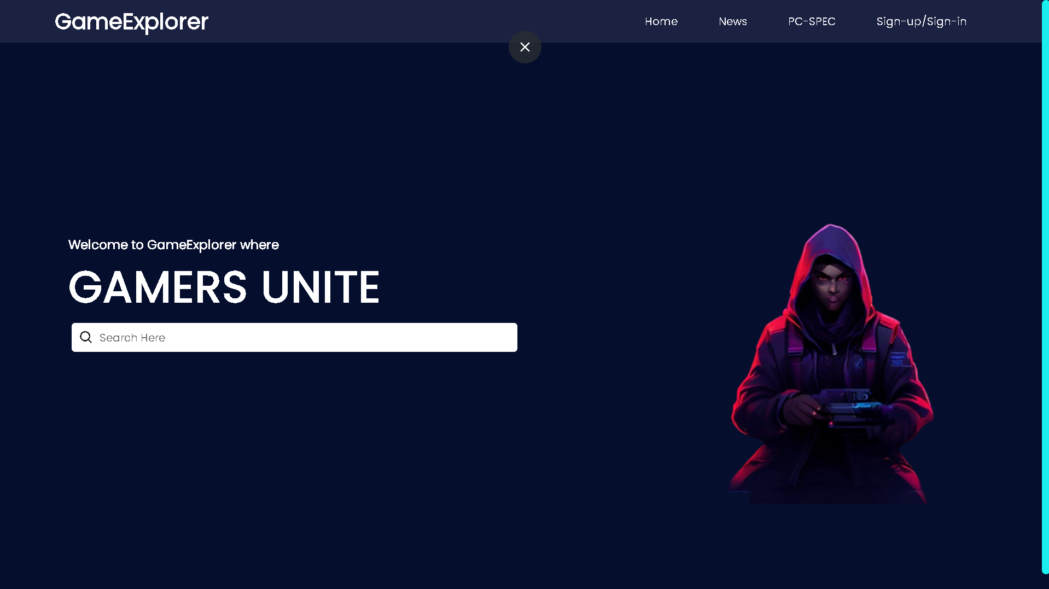
Screenshots
Index page

Slide 7
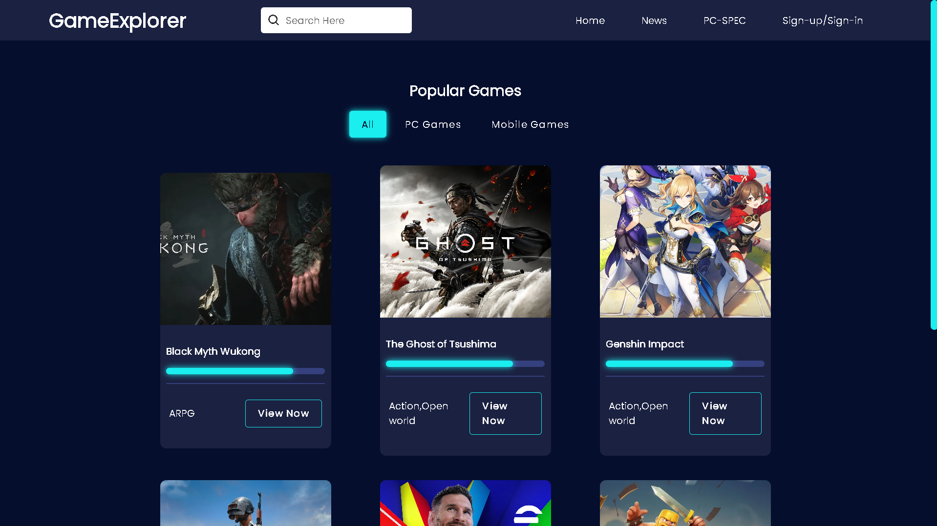
Home page

Slide 8
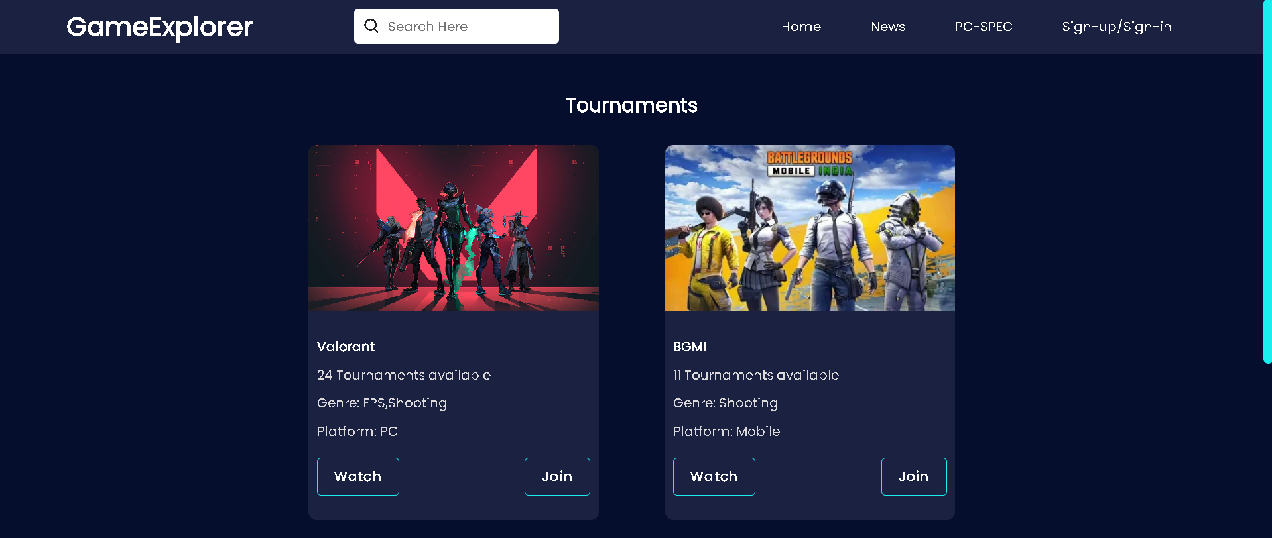
News page

Slide 9
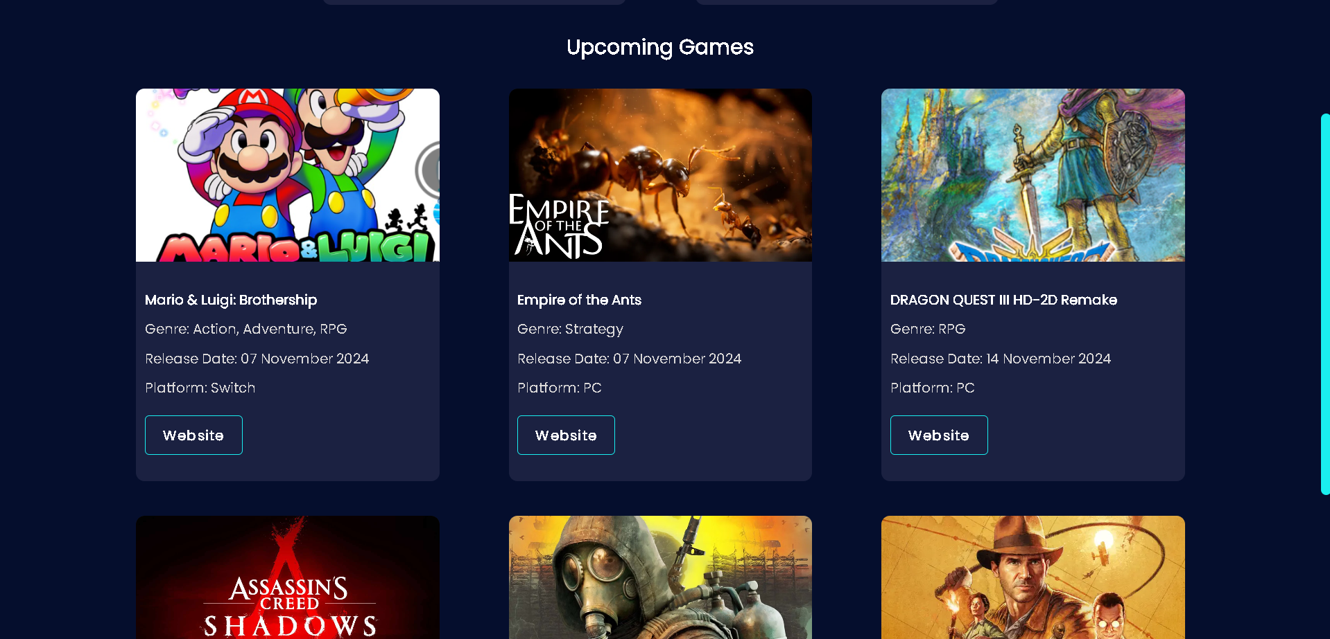
Future Games

Slide 10
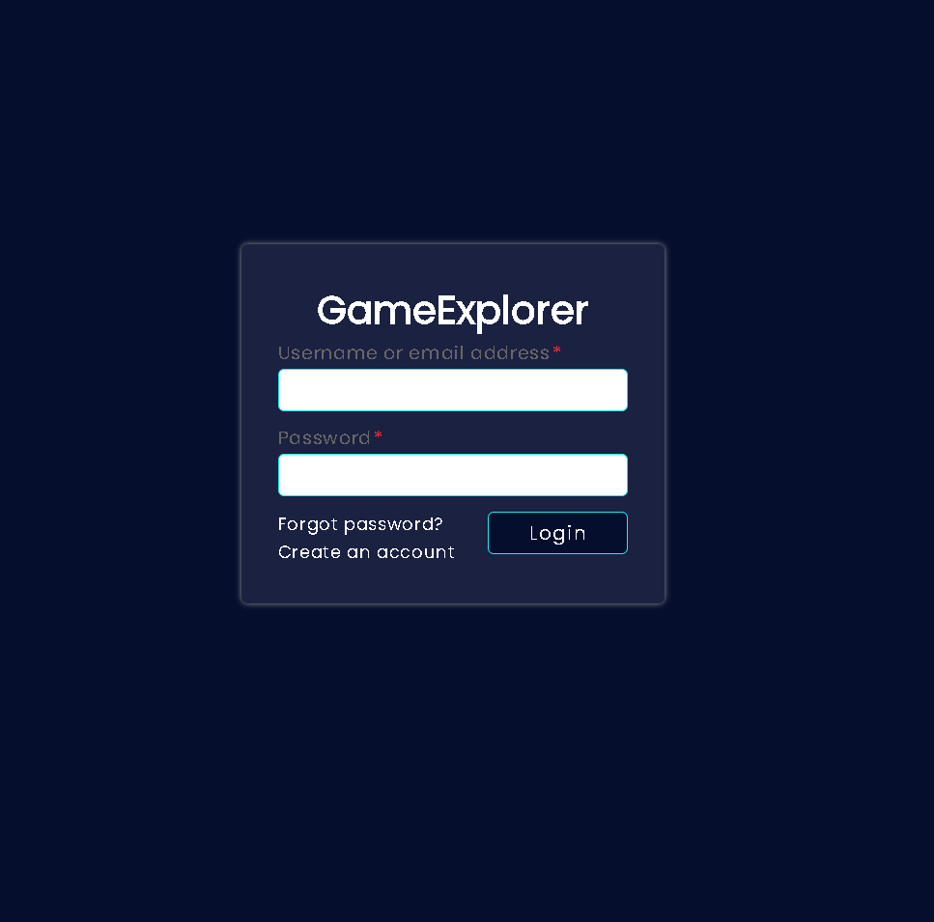
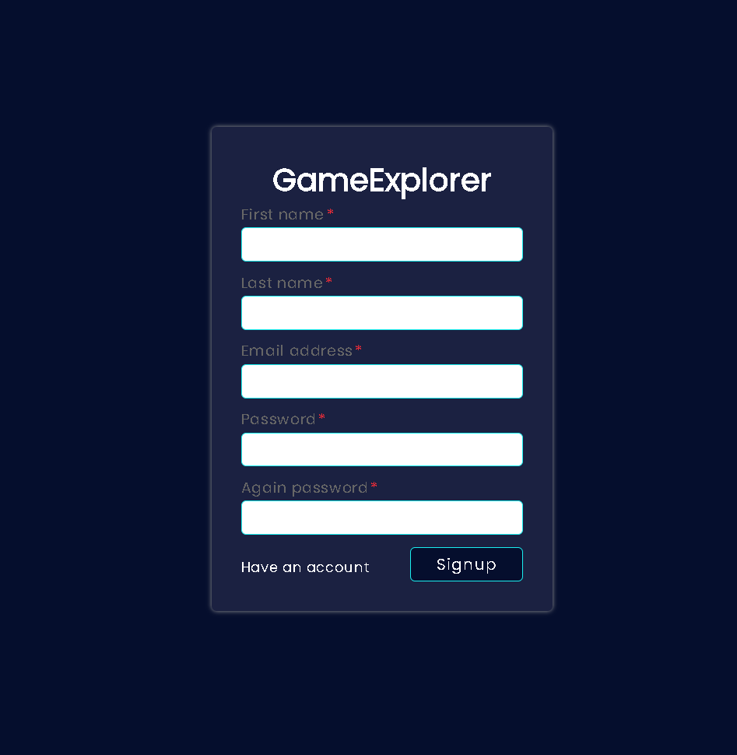
Login page
Registration page

Slide 11




Remaining Works
Game Explorer continues to evolve and expand its functionality.
Content Expansion
Adding more games, reviews, and news articles.
Expected to finish on 10th October 2024
Community Features
Developing advanced community tools and features for interaction.
Expected to finish on 6th October 2024
Personalization & Recommendations
Refining the recommendation engine and user experience.
Expected to finish on 5th October 2024
AI Implementation
Implementing an AI to help users find their favorite games.
Expected to finish on 30th September 2024

Slide 12

Thank You
Thank you for your interest in Game Explorer.

